Slide 1
Romans 8:16-25

Slide 2
¹⁶ The Spirit himself bears witness with our spirit that we are children of God, ¹⁷ and if children, then heirs—heirs of God and fellow heirs with Christ, provided we suffer with him in order that we may also be glorified with him.
¹⁸ For I consider that the sufferings of this present time are not worth comparing with the glory that is to be revealed to us. ¹⁹ For the creation waits with eager longing for the revealing of the sons of God.

Slide 3
²⁰ For the creation was subjected to futility, not willingly, but because of him who subjected it, in hope ²¹ that the creation itself will be set free from its bondage to corruption and obtain the freedom of the glory of the children of God. ²² For we know that the whole creation has been groaning together in the pains of childbirth until now.

Slide 4
²³ And not only the creation, but we ourselves, who have the firstfruits of the Spirit, groan inwardly as we wait eagerly for adoption as sons, the redemption of our bodies. ²⁴ For in this hope we were saved. Now hope that is seen is not hope. For who hopes for what he sees? ²⁵ But if we hope for what we do not see, we wait for it with patience.

Slide 5
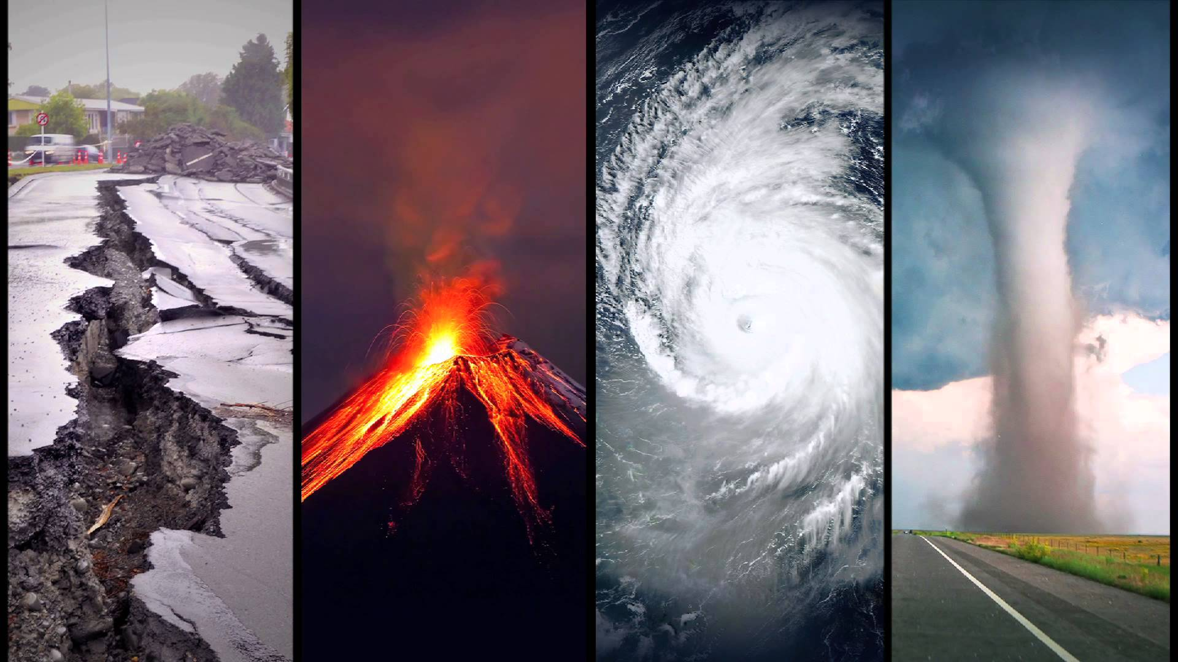
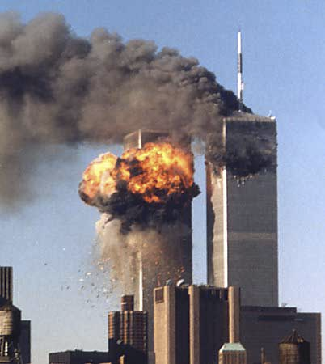
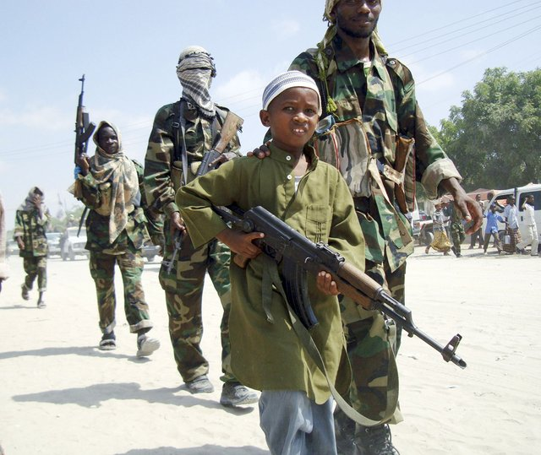
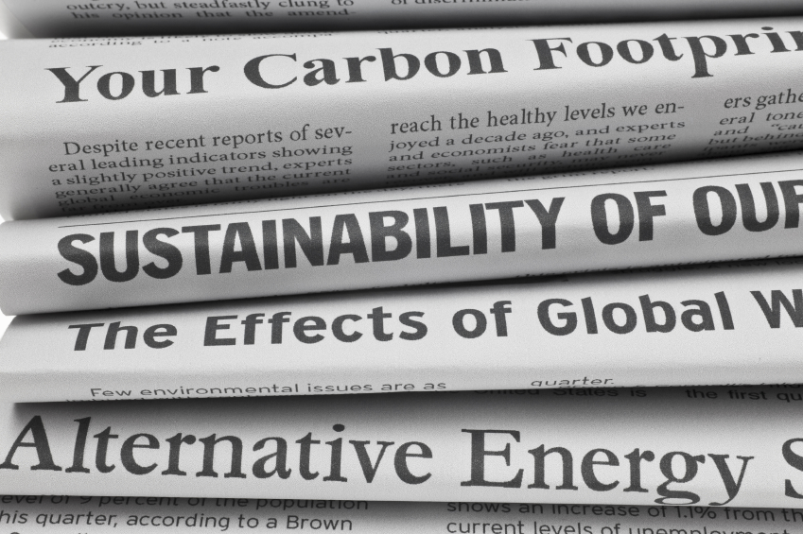
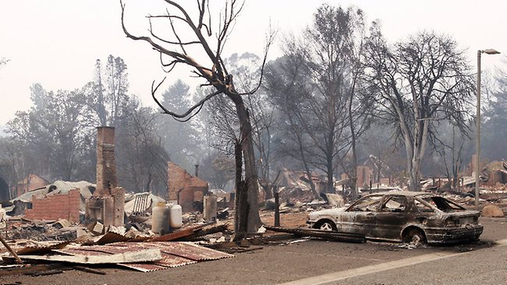
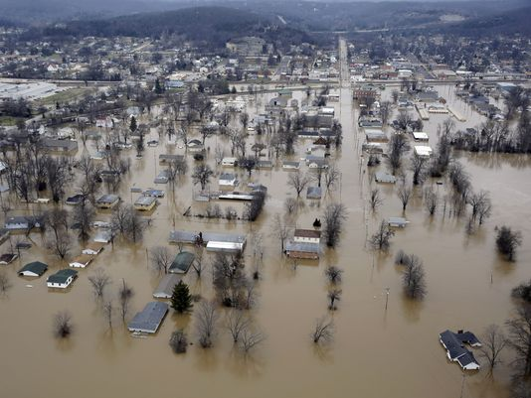
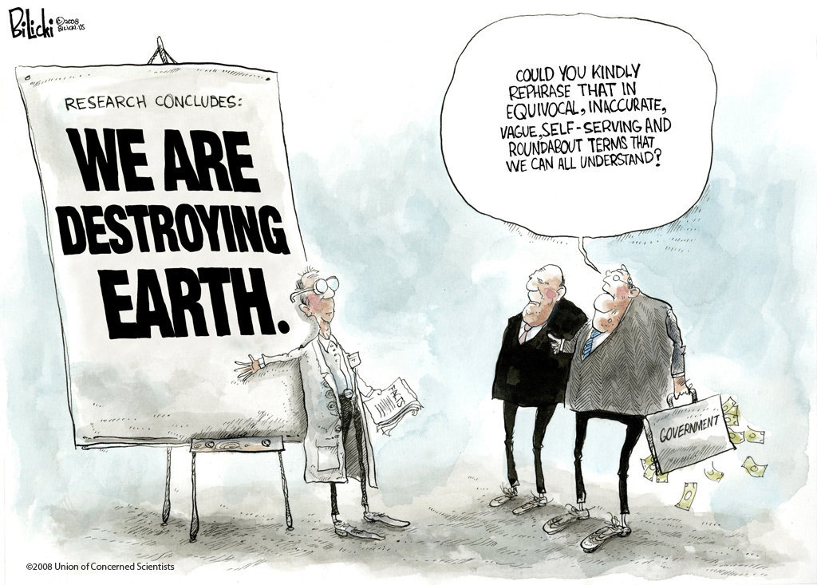

Slide 8
There’s something wrong with our world. Broken/Decaying
The world and its condition are in God’s hands
humanity sinned against God
man and creation were cursed because of this sin
God subjected creation to this, And will one day fix it
Creation groans (disaster; disease; war; climate)
²¹ .... creation itself will be set free from its bondage to corruption and obtain the freedom of the glory of the children of God
God’s plan, is to redeem His Children & creation itself

Slide 9
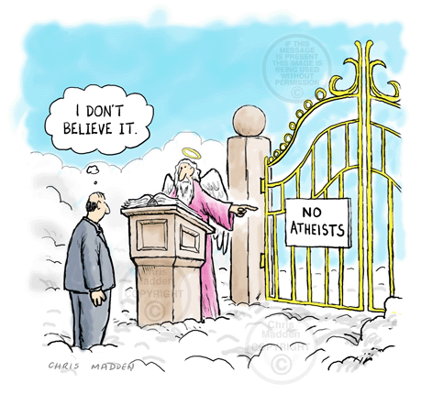

Slide 10
21 Then I saw a new heaven and a new earth, for the first heaven and the first earth had passed away, and the sea was no more. ² And I saw the holy city, new Jerusalem, coming down out of heaven from God, prepared as a bride adorned for her husband. ³ And I heard a loud voice from the throne saying, “Behold, the dwelling place of God is with man. He will dwell with them, and they will be his people, and God himself will be with them as their God. ⁴ He will wipe away every tear from their eyes, and death shall be no more, neither shall there be mourning, nor crying, nor pain anymore, for the former things have passed away.”

Slide 11
There’s something wrong with our world. Broken/Decaying
The world and its condition are in God’s hands
humanity sinned against God
man and creation were cursed because of this sin
God subjected creation to this, And will one day fix it
Creation groans (disaster; disease; war; climate)
²¹ .... creation itself will be set free from its bondage to corruption and obtain the freedom of the glory of the children of God
God’s plan, is to redeem His Children & creation itself
The old heavens & old Earth are passing away
God will live with us on the New Earth
The glorification and renewal of the Earth is bound up in the glorification of God’s children
A sure and certain hope. Christians & Creation in Glory

